Slide 1

Grasshopper V5
For
Conceived and realised by: Bozzy & That Grasshopper Guy

Slide 2
Where is Grasshopper today:

Slide 3

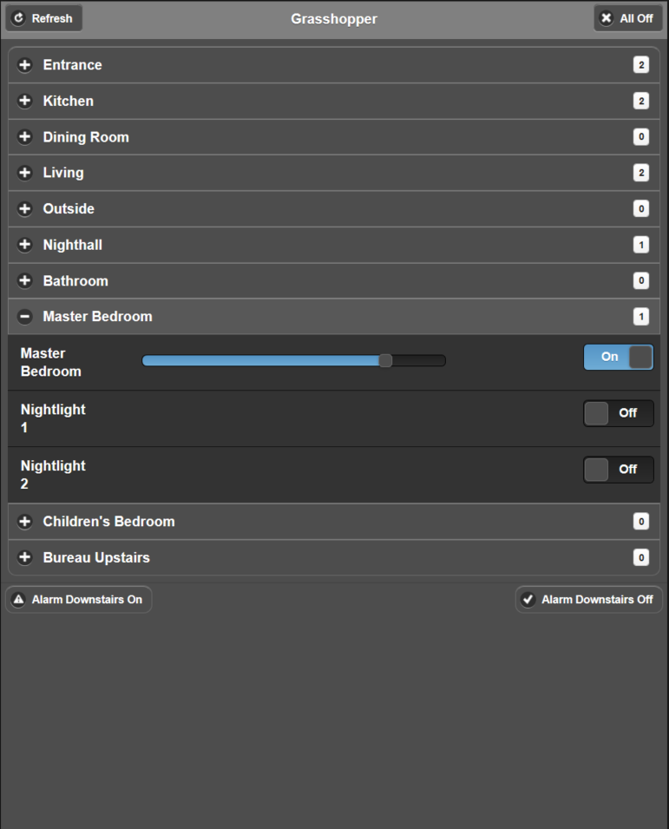
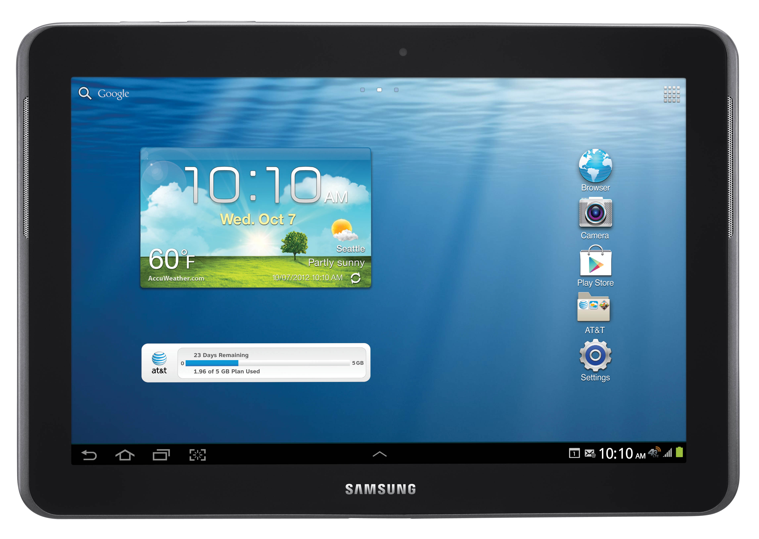
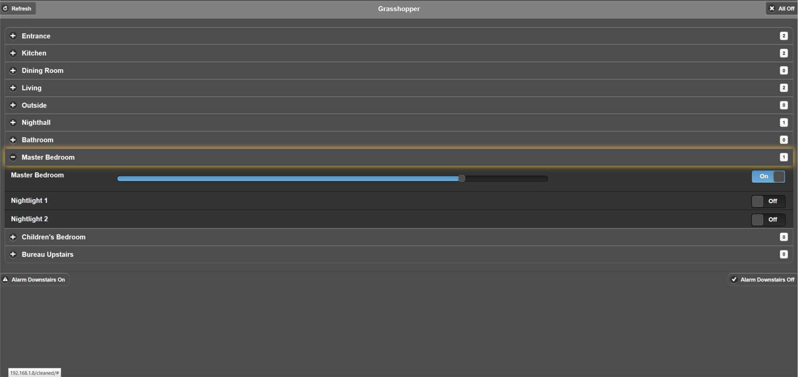
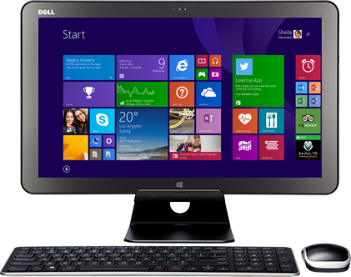
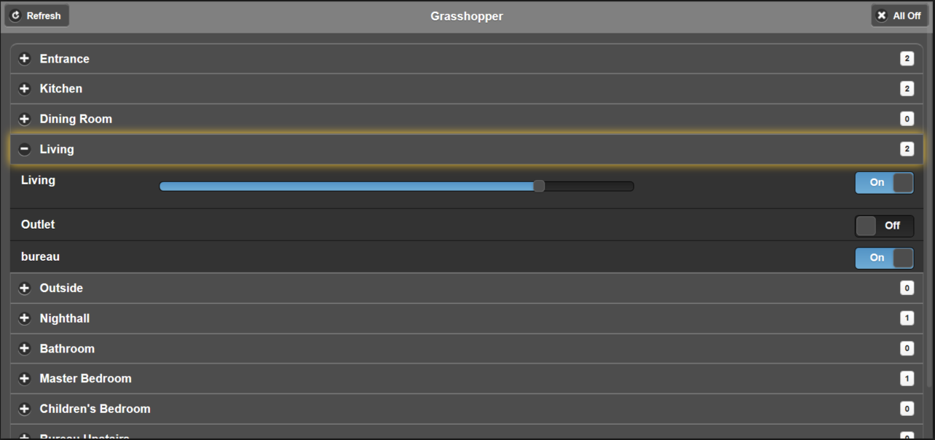
Control from any device:
1.
Control Bticino MyHome from any device
- Windows / Linux PC
- iOS → iPhone or iPad (Any version)
- Android → Phone or Tablet (Any version)
- Windows Phone
- …
Why is this possible?
Grasshopper is a browser application,
not a native app.

Slide 4
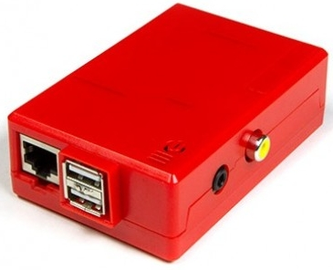
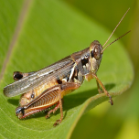


Appliance | application
1.
2.
3.
Grasshopper comes in 2 flavours:
Appliance
  Quick & easy installation of
  grasshopper V5.img disk image
  on Raspberry Pi
Application
  Use your own Linux server
  with LASP / LESP / …
  To run the Grasshopper web app

Slide 5
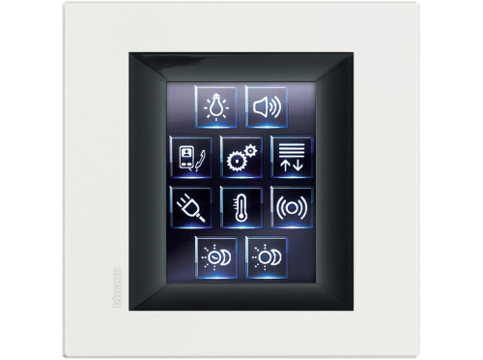
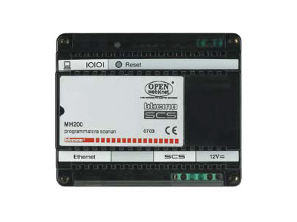

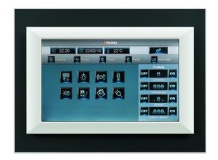
Official & unofficial gateways
4.
5.
Grasshopper communicates with:
- Official gateways
  MH20x
  F452
  F454
  …
Non-official gateways
  MyHOME_Screen 10
  Touchscreen 3,5"
  …
From an IP address inside & outside the trusted IPs configured in MyHome

Slide 6
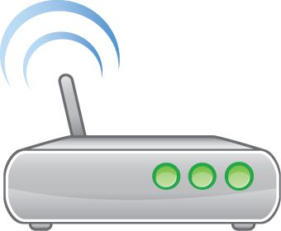
Grasshopper = Freedom
1.
2.
3.
4.
5.
Device
Freedom
Server
Freedom
Gateway
Freedom

Slide 7

Isn’t this too complex for me?
I’m a great electrician,
not a developer!

Slide 8

My wife is a
I’m not saying my wife is stupid…..
she just isn’t that good with computers
However, she did manage to
install and configure Grasshopper V5
in under 40 minutes

Slide 9
Let me show you:

Slide 10

How do I start
I am a
Appliance
Application
Download & extract
Grasshopper_V5_Appliance.zip
Install following
Install&Config Guide
Chapter 2
Configure

Slide 11
How do I start?
Download the application from Sourceforge
Install the appliance
  Have your Raspberry Pi ready
  Follow the installation & configuration guide
Leave a nice comment on your experience
Join the community and give form to V6

Slide 12
Grasshopper V5
For
Conceived and realised by: Bozzy & That Grasshopper Guy

Slide 13
Where is Grasshopper today?

Slide 14
Value of Grasshopper as
Free Software
You are:
  Free to use the code (Gratis)
  Free to redistribute copies
  Free to change the code
  Free to re-use parts of the code
  Free to analyse the source code
  Free to participate in our community
    (➔ contact us if you want to join!! We are hiring!)
    See license chapter in “Installation & Configuration Guide”

